Slide 1

Language Detection Model Using Deep Learning
HPE Internship Group-8
Sonal Ganvir, Anurag De

Slide 2

Problem Statement
Input:
10 Multi-lingual Languages {European
texts}
Expected Output:
Detect all languages with the percentage distribution of input texts.

Slide 3
Procedure
Data Collection & Processing
Feature Engineering
Model Creation
Deploying model as API
Converting word 2 vector via one-hot encoding format.
Design and train the model as DNN (Deep neural network)
Save the model with best accuracy score and less ‘Loss’ value.
Collected dataset from HC Corpus which contains 10 European Languages of
100k Wordlists:
English, Danish, Dutch, French, German, Italian,
Polish, Portuguese,
Spanish, swedish
Loading the model with prediction function of detecting % distribution of language in Flask API.
Deploying the API in website.

Slide 4
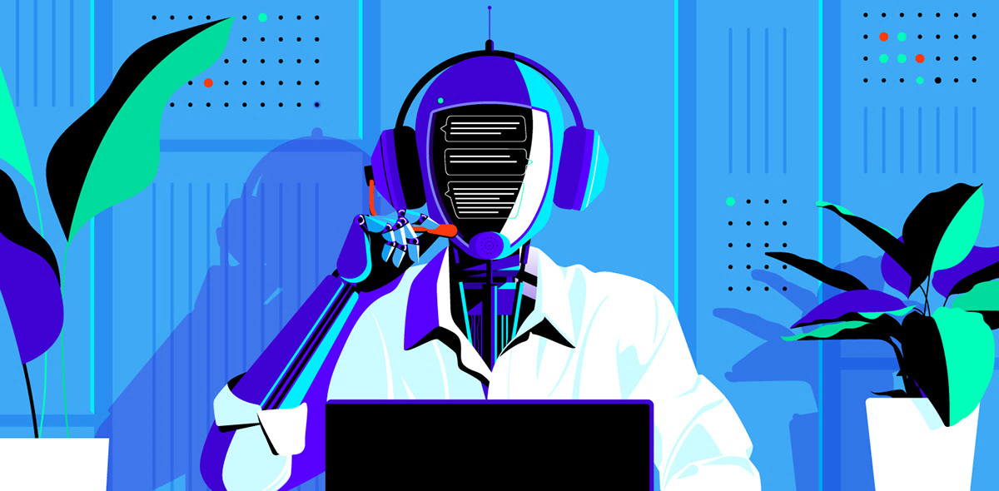
Quality aspect of product
Reliability, User can reliable on the this product as it gives same result consistently at anytime, any browser environment, any operating system where the product is operated .
Serviceability, Developer can easily monitoring the system and repair or upgrade the product easily as per the their requirement
Performance, User can get result within 0.23 seconds per sentence , 4.94 seconds per paragraph(30 words).

Slide 5

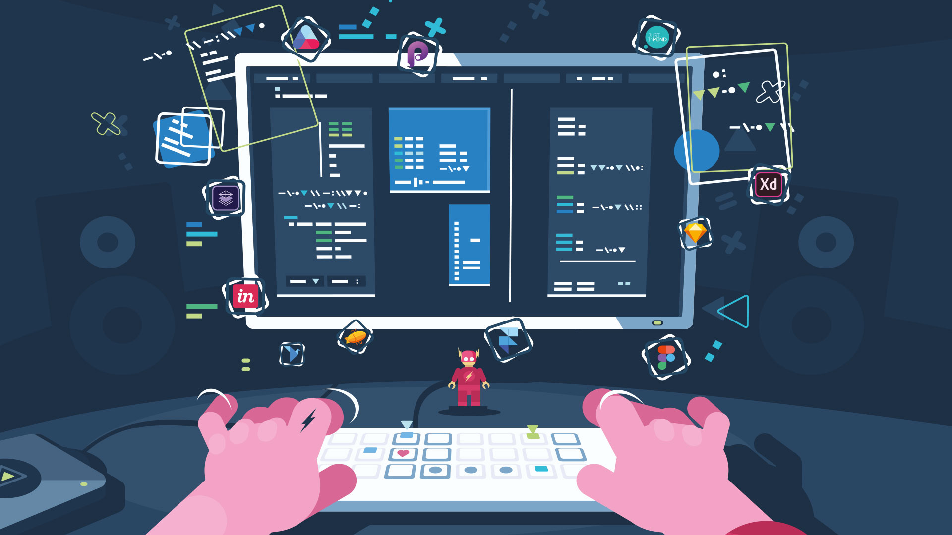
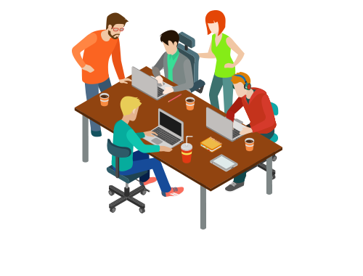
Business Prospect
Many apps require language detection so that they can customize/personalize their user settings or data automatically.
Eg.
Customizing/suggesting E-books, blogs, websites preference for a user.
Multilingual search engine.(Efficient query searching)
Acts as similarity index for two documents.
Subtitles classification
Auto replace/detect next word in multi-language keyboard.
Decoding language for a general user doesn't know anything about that language.

Slide 6
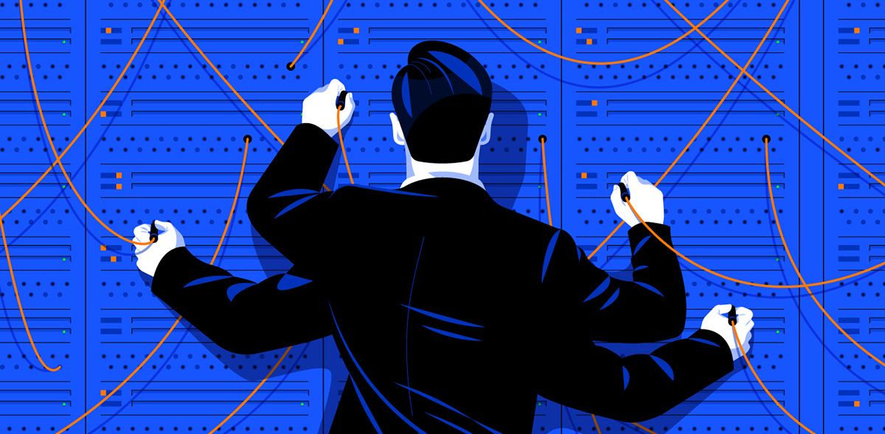
Further development
After sprint retrospective , this model could for further improvement in neural network architecture.
The data word list could be increase to 200k or 300k for each language.
Language detection type can be expand via OCR-Scanner, PDF Scanner, file upload & drawing board.

Slide 7


The _End

